Slide 1
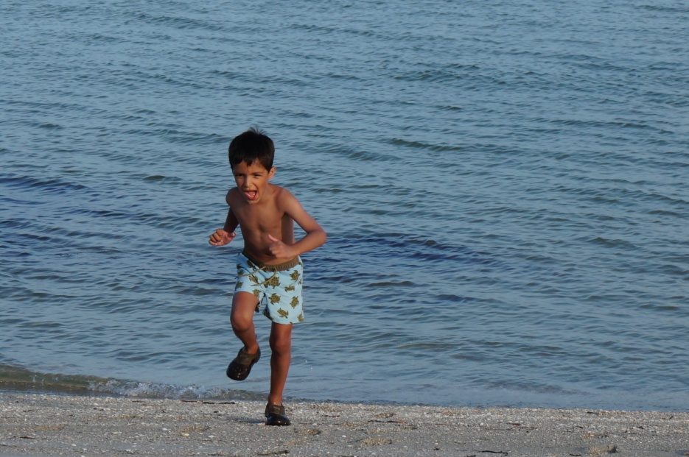
All about me
Ahmed Ingham

Slide 2
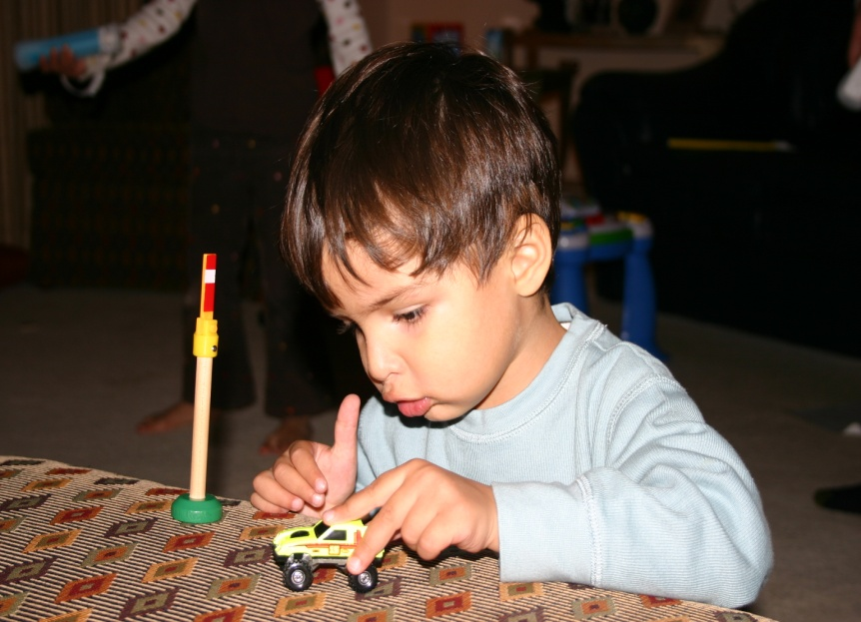
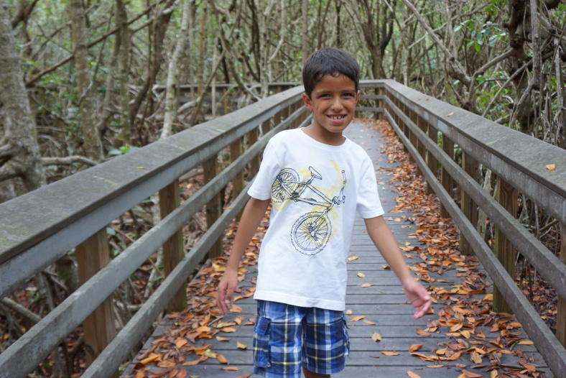
About me
I was born on April 17th, 2008. I am the youngest in the family. My sister is 12 and in 8th grade. She plays soccer. My mom works for a long time at her work. Dad stays at home. I like seeing my aunts and uncles.

Slide 3
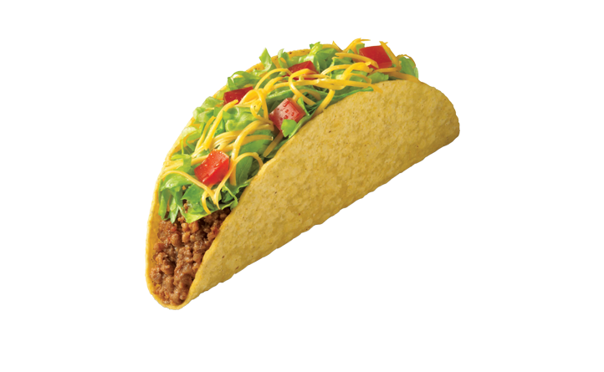
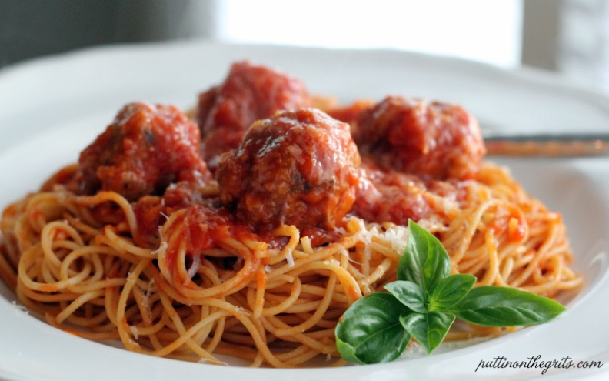
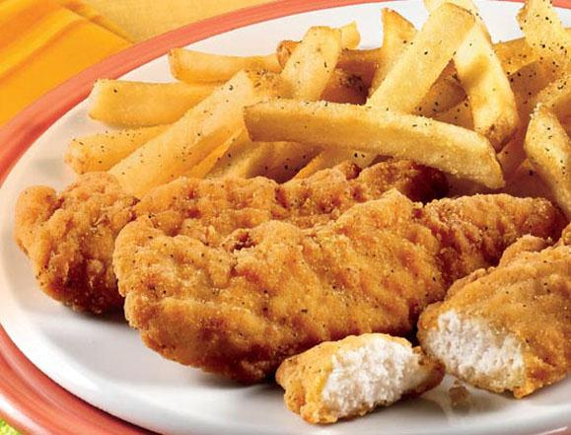
Favorite Food
I love Cuban food. I like Tacos. I also like French Toast and Pancakes. I like Chicken Tenders. I like Pasta and Meatballs.

Slide 4
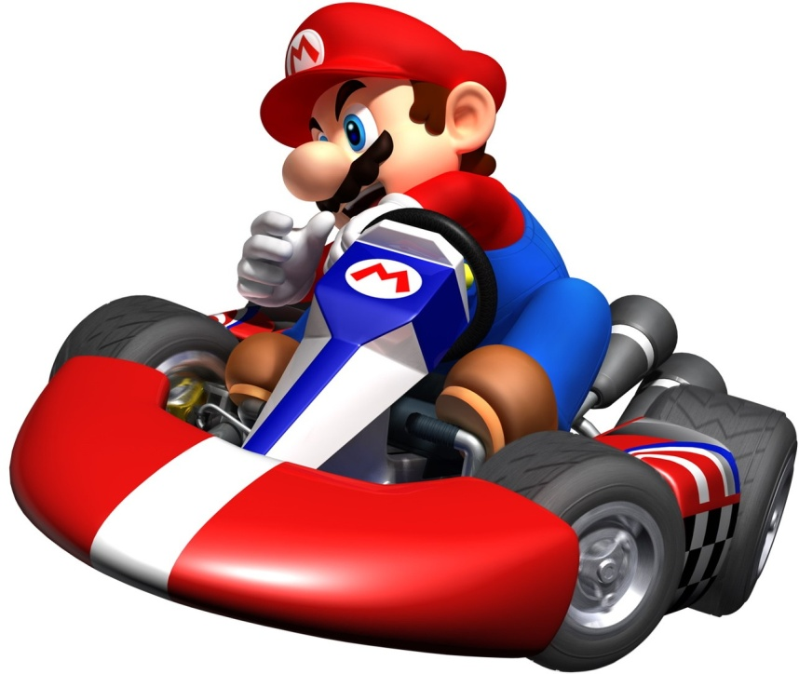
Playing Games
I like playing Mario games on Wii and on the DS. I play games on my Samsung. I have Super Mario Galaxy 1 and 2. I also have super Mario bros.

Slide 5
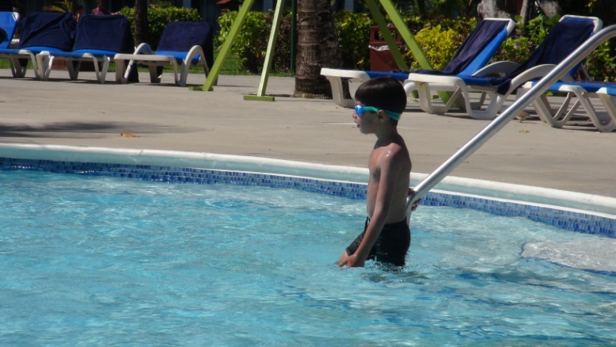
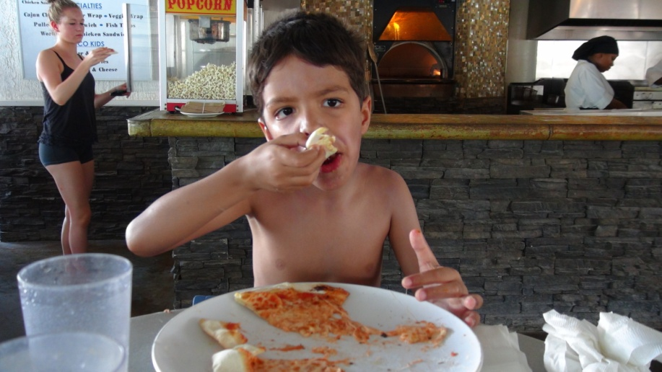
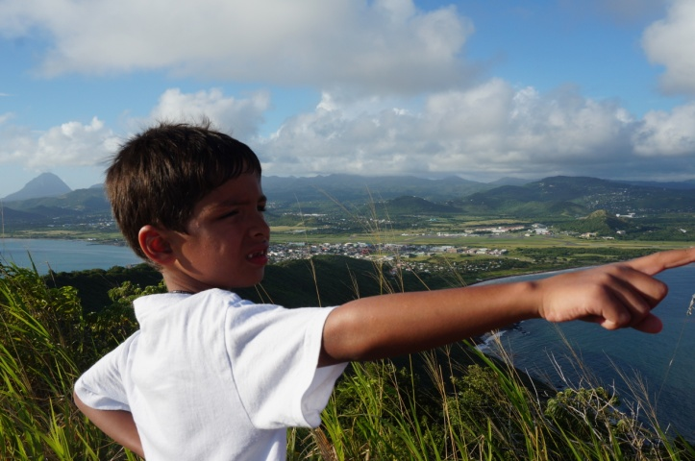
I love Vacation
I have been to Florida, North and South Carolina, Tennessee, California, St. Martin and St.Lucia. St.Lucia had the best pizza ever. I swam in the pool.

Slide 6
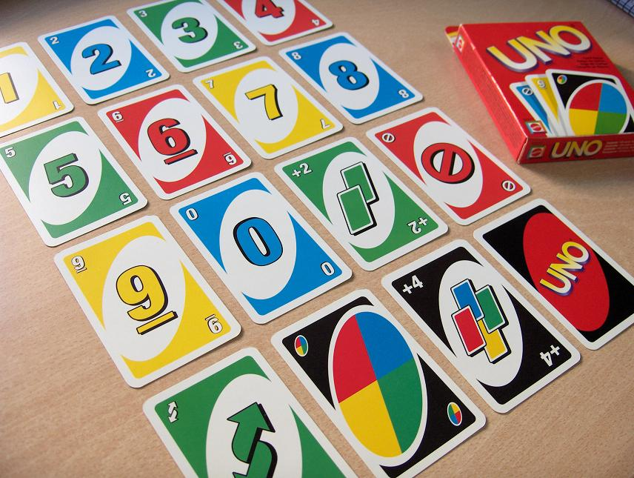
My hobbies
I like reading .
I like playing outside.
I like playing board games. I like writing.

Slide 7
My wishes for 3rd grade
I wish my teachers will be nice.
I hope I learn new things.
I hope 3rd grade is fun.
I hope I get good grades.

