Slide 1
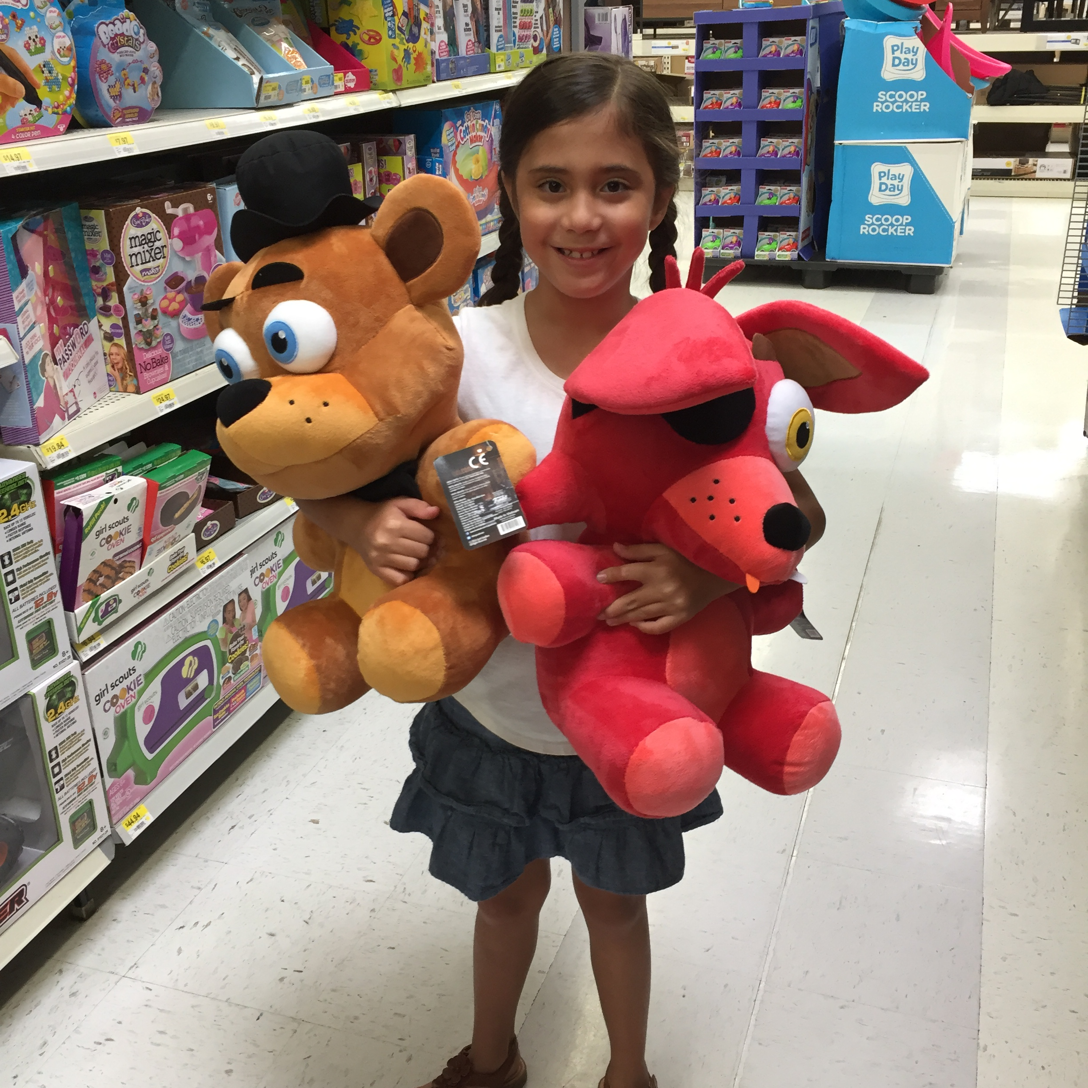
Nicolette’s Life ☺

Slide 2
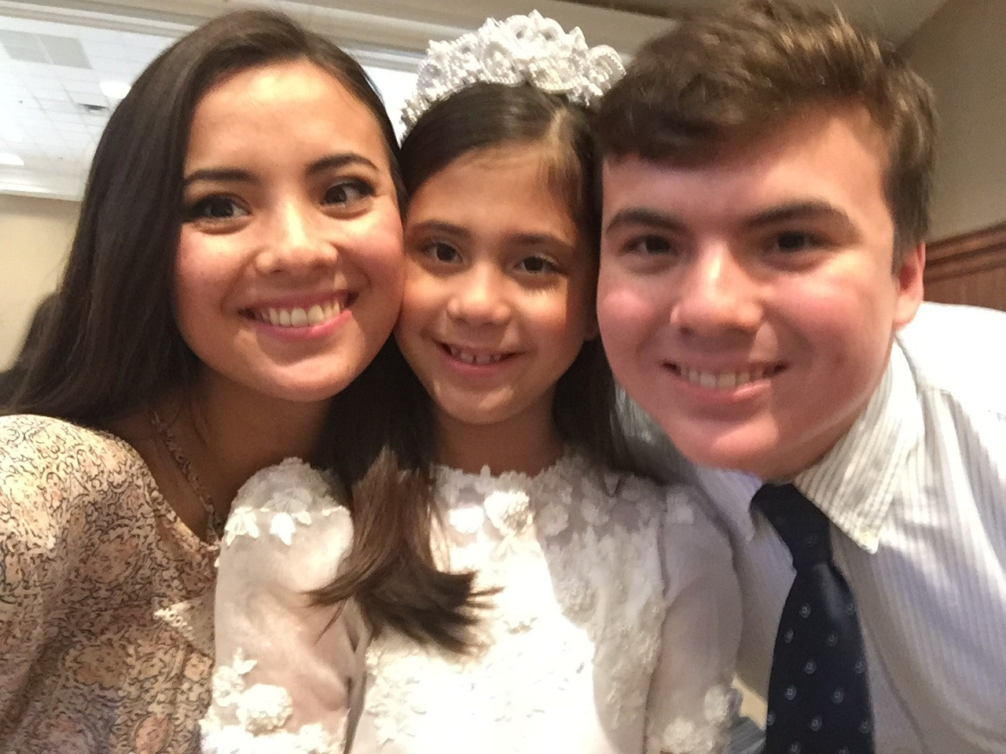
Siblings
I have a sister and brother and their names are Camilla and Alex.
My sister is 21 and my brother is 16.
I love my family.

Slide 3
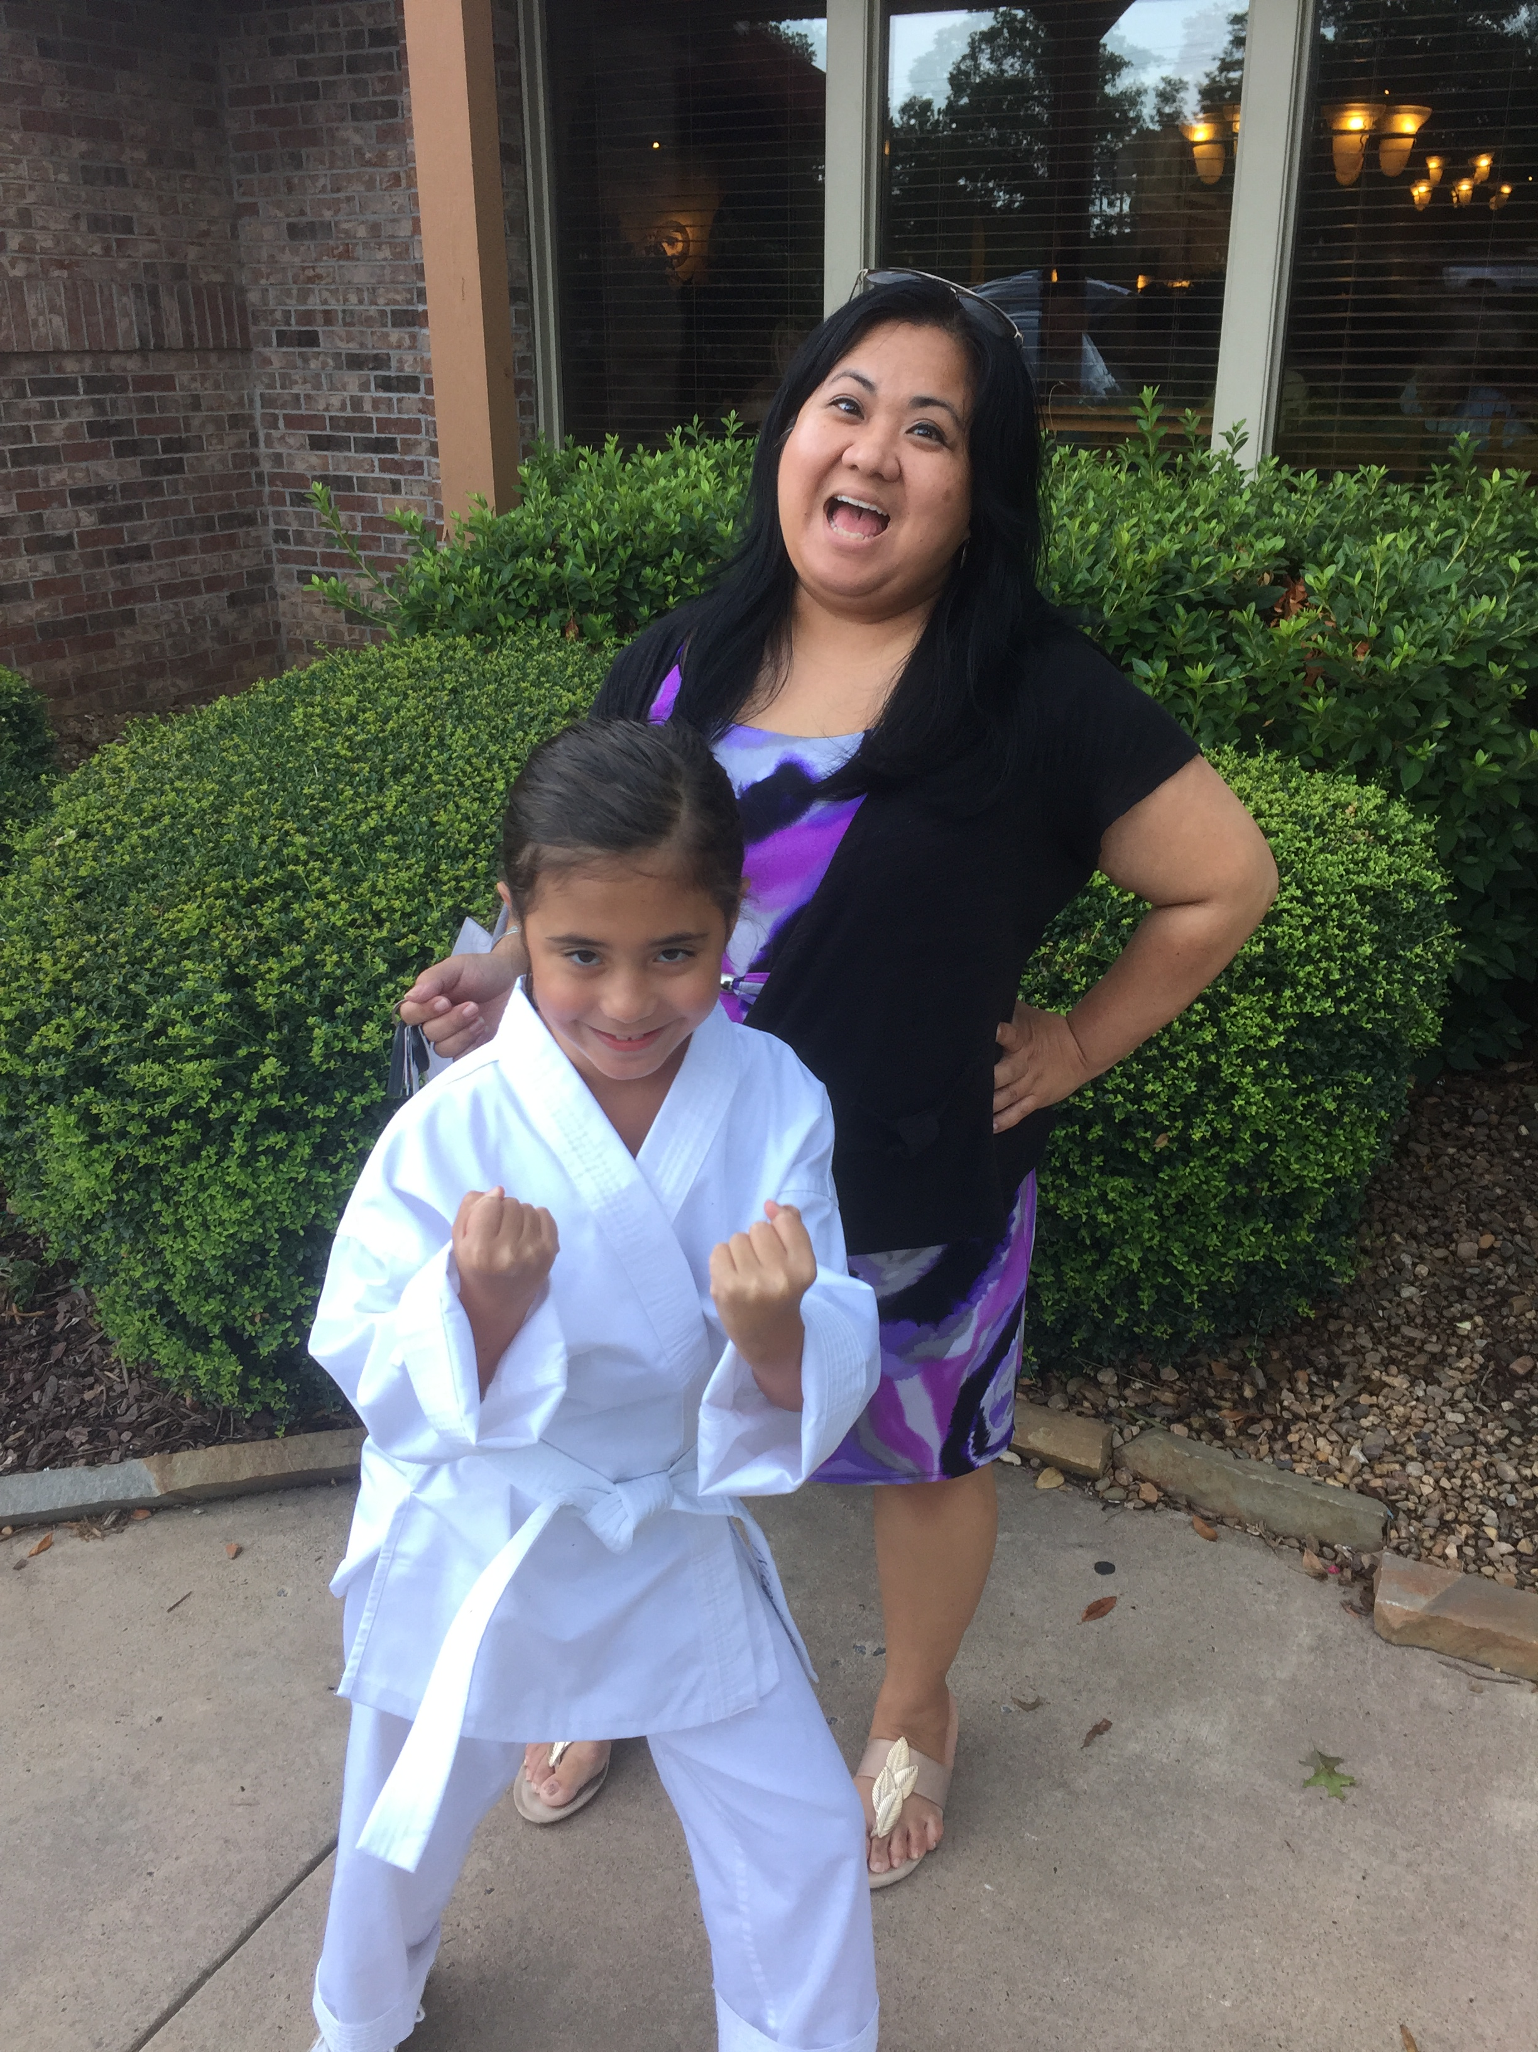
I have a mom named May Fornes.

Slide 4
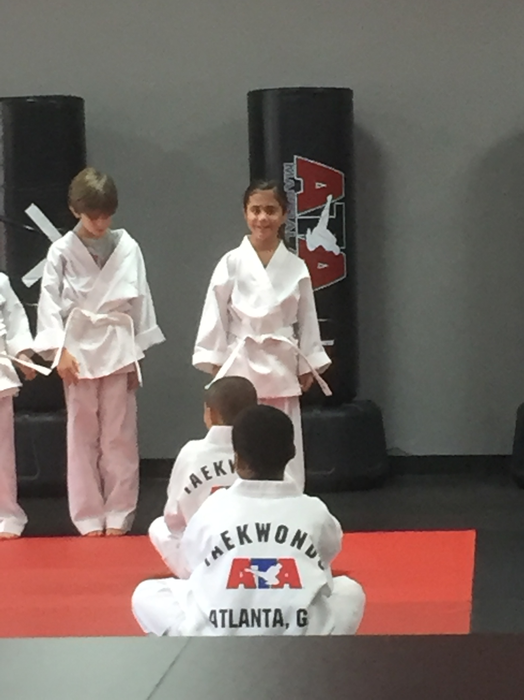
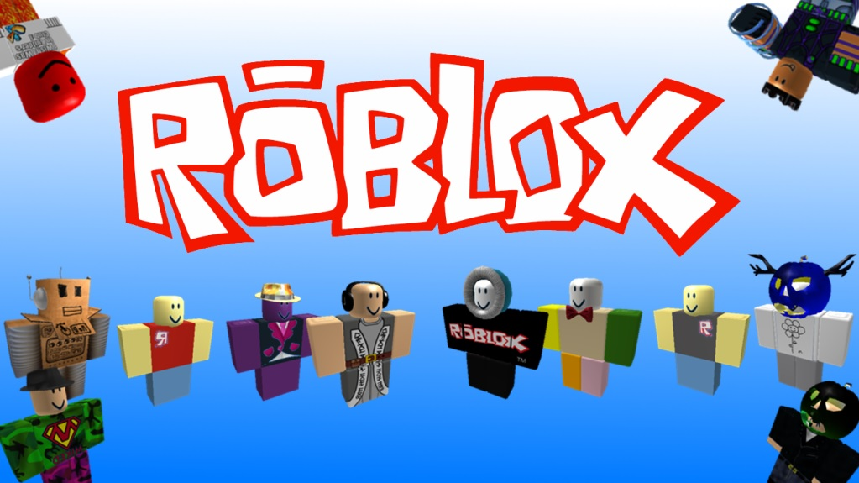
I mostly do taekwondo and play roblox.

Slide 5
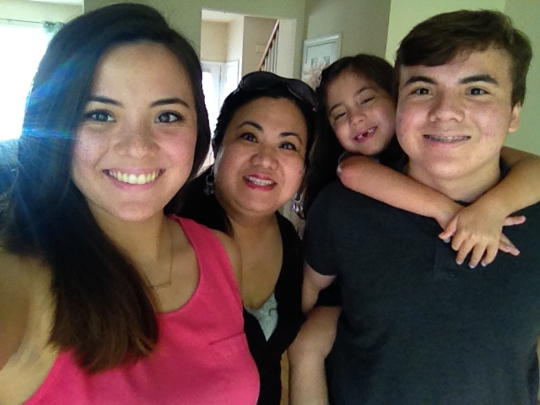
I love my family and home.

Slide 6
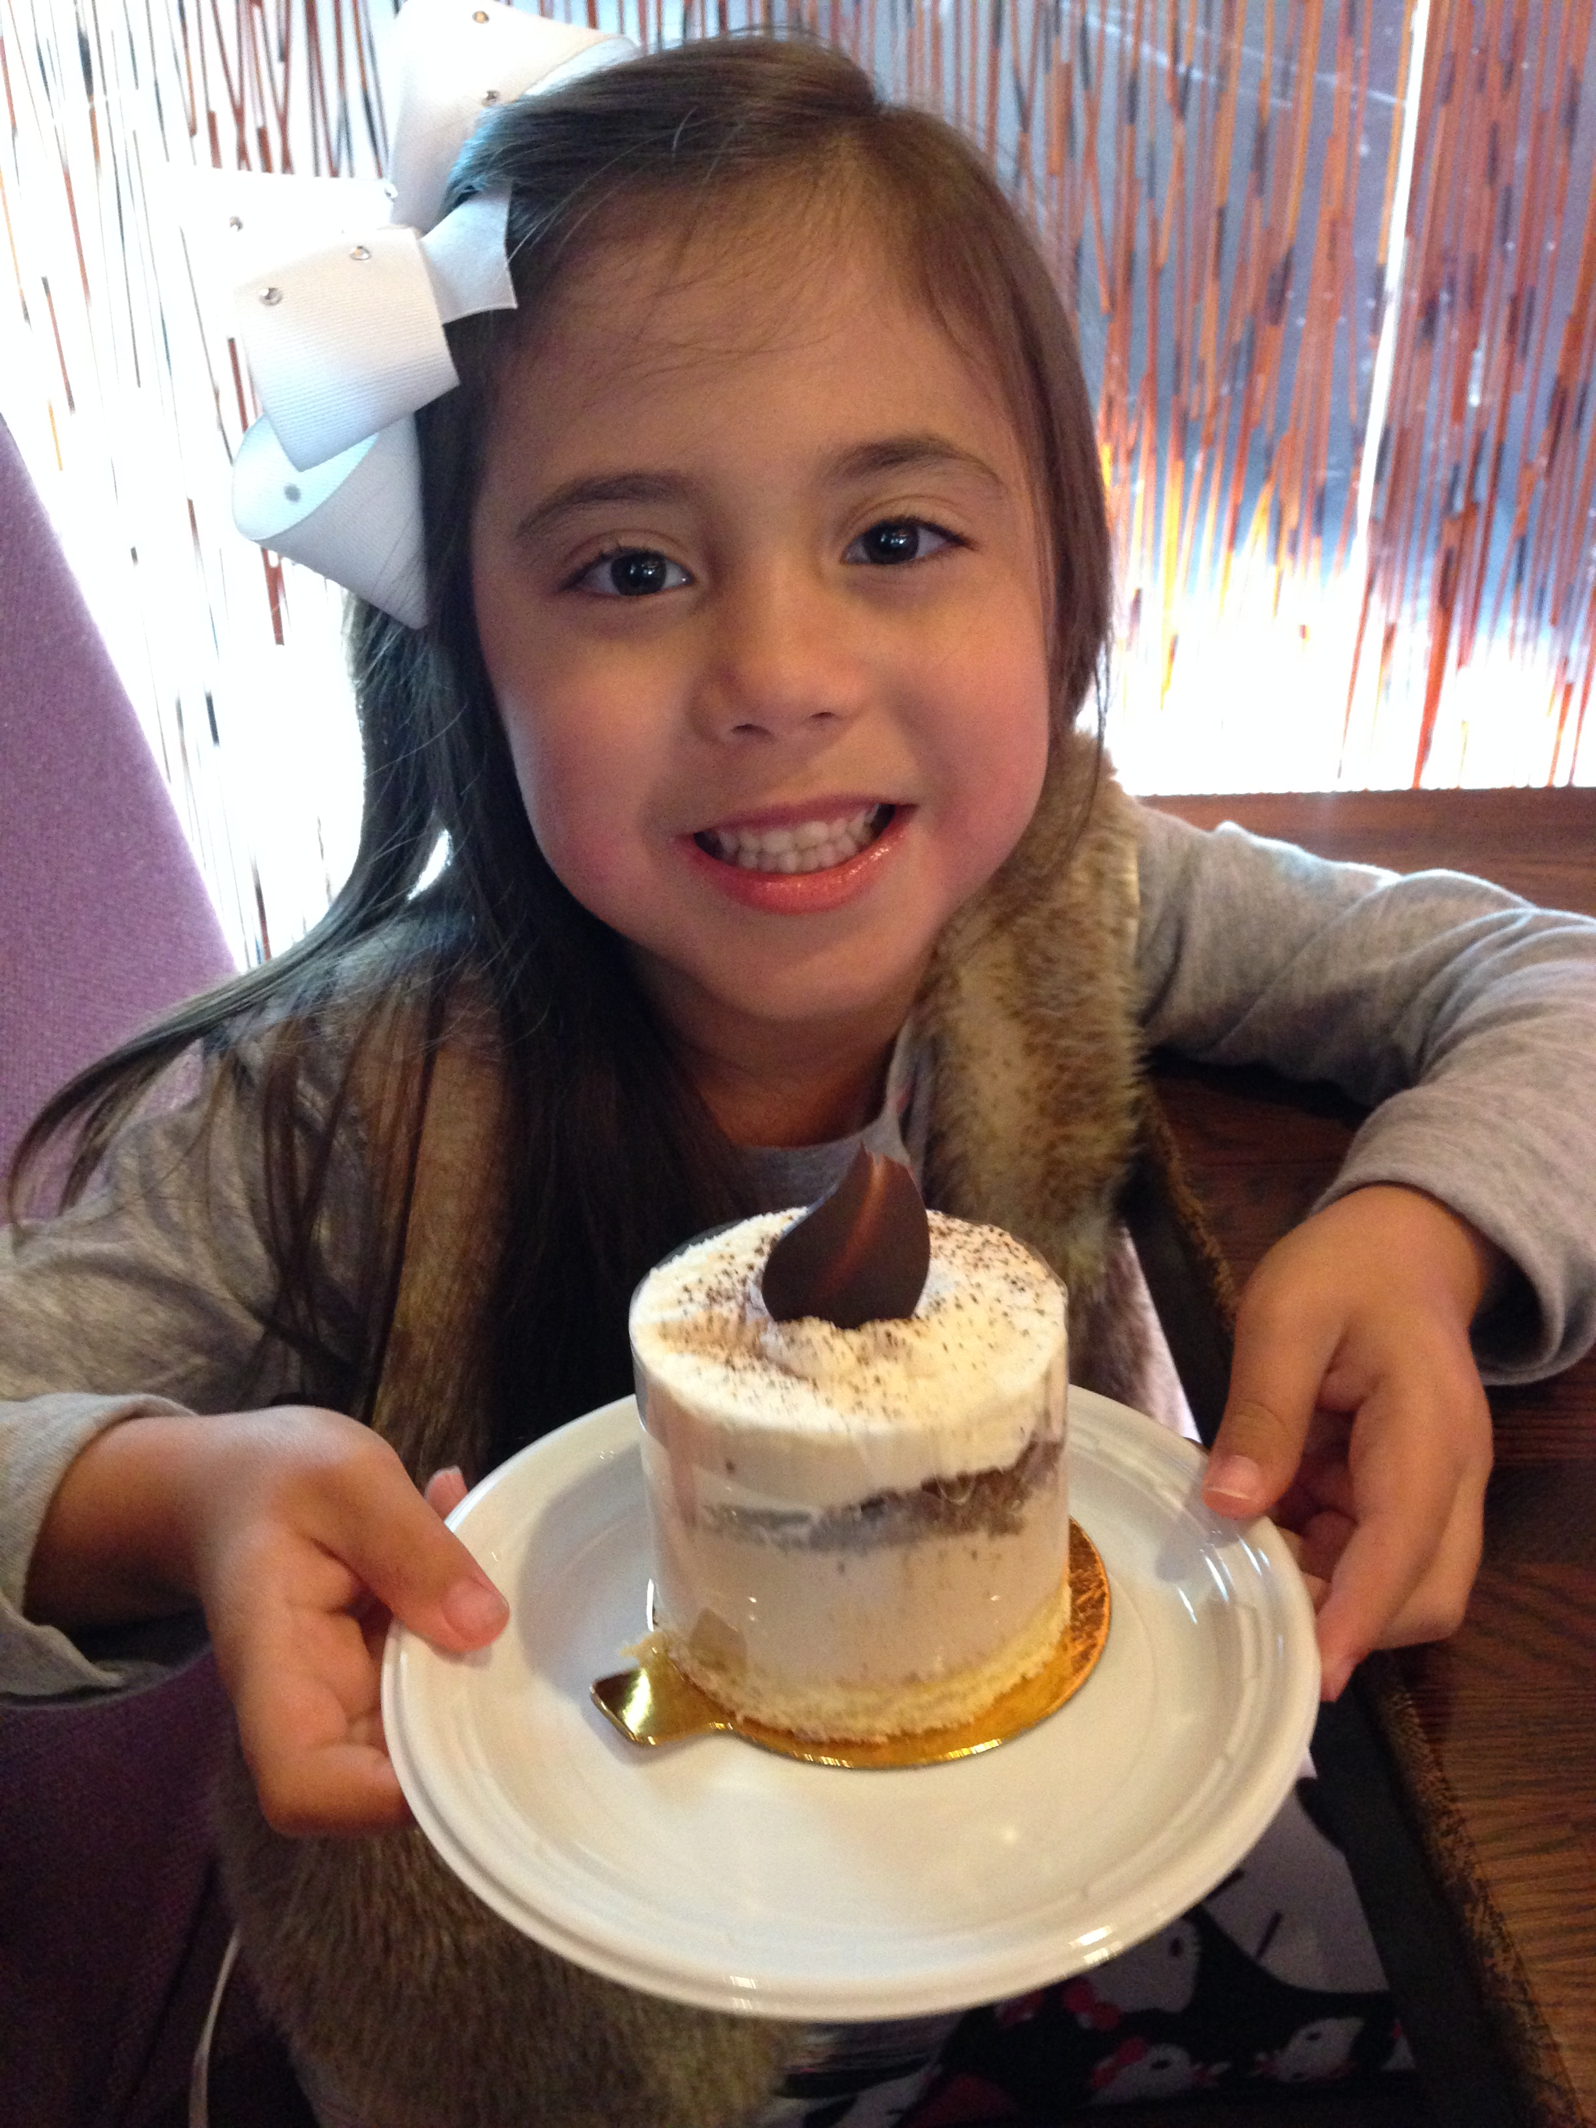
I like CHOCOLATE AND
SWEETS!

Slide 7
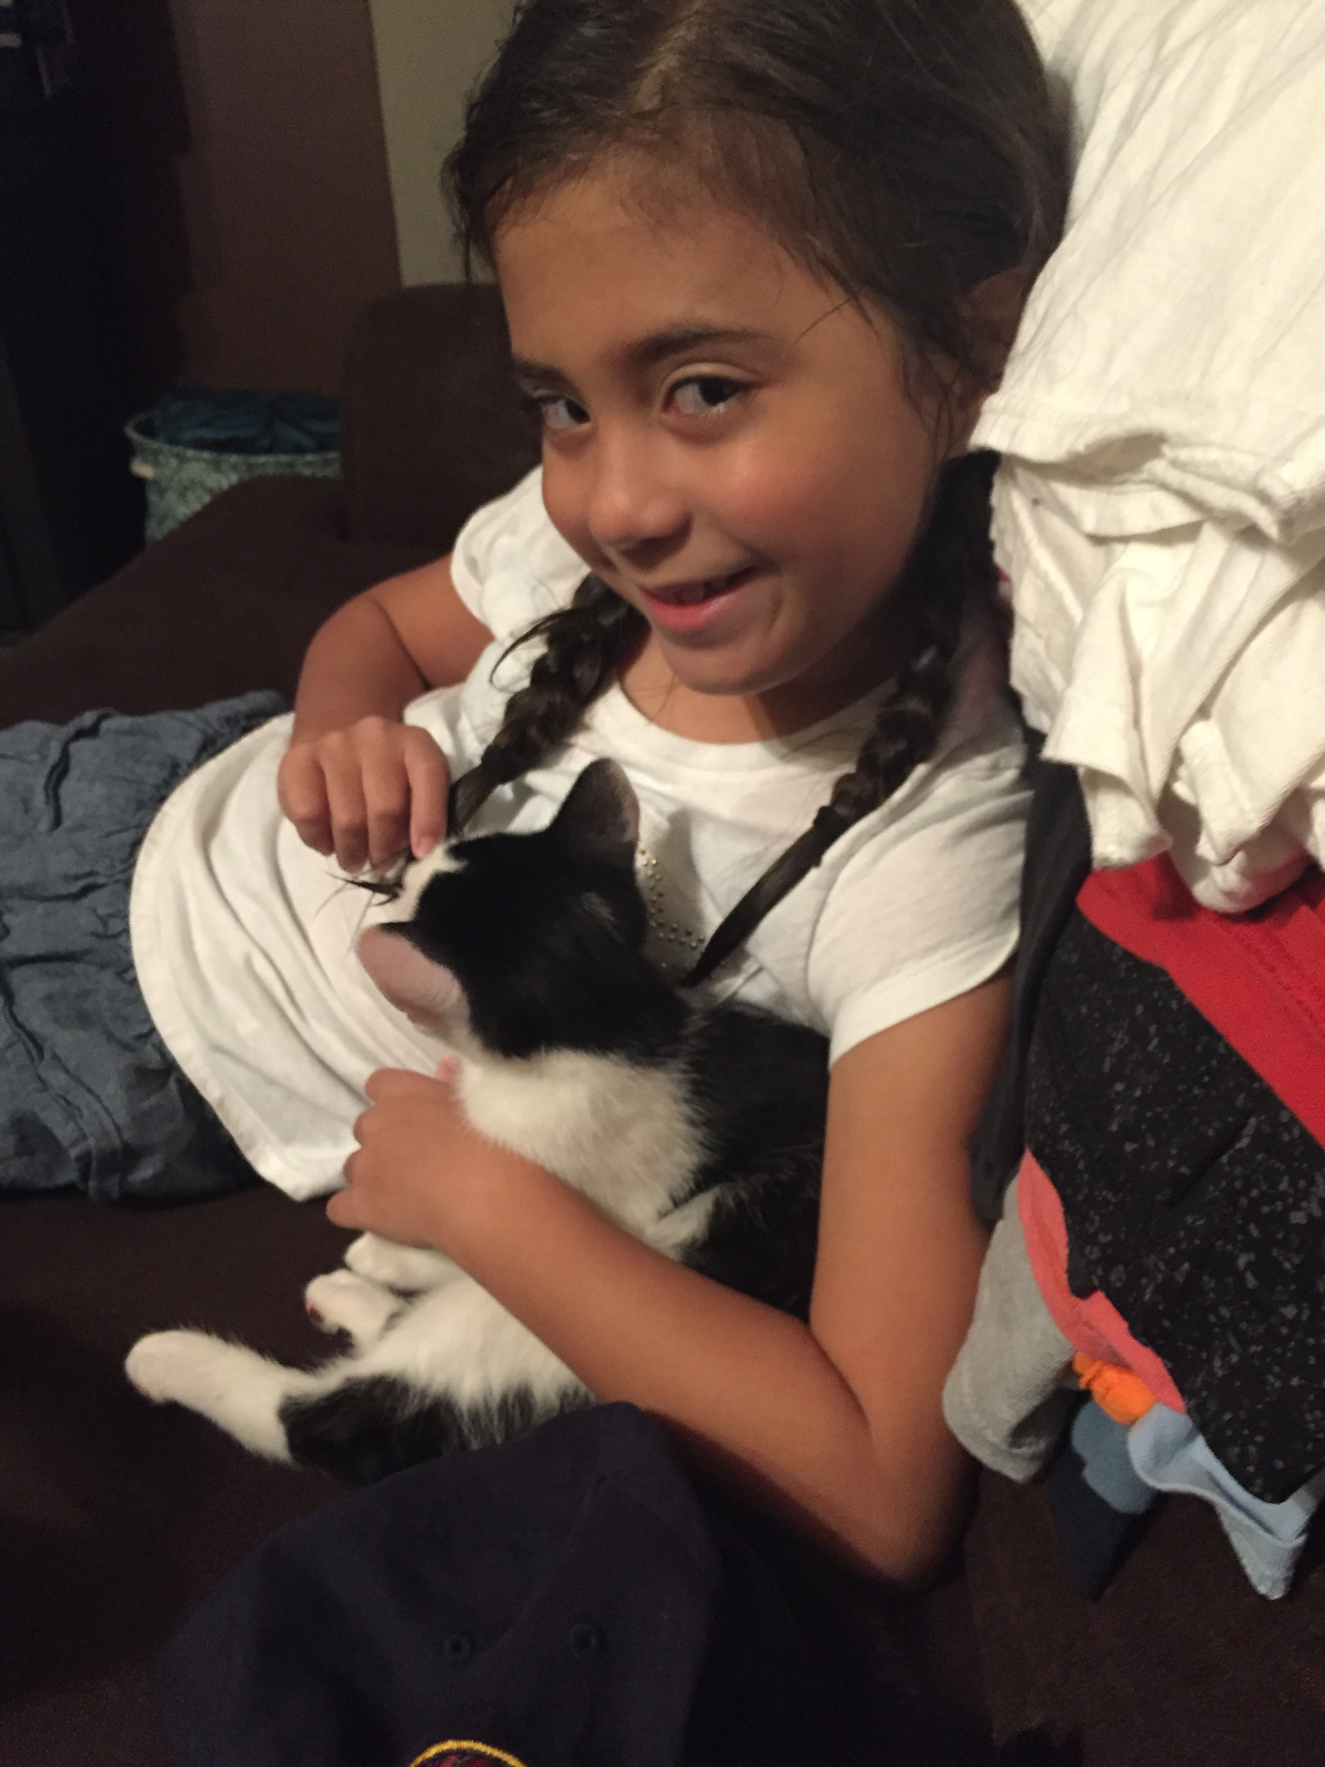
I love animals!

