Slide 1
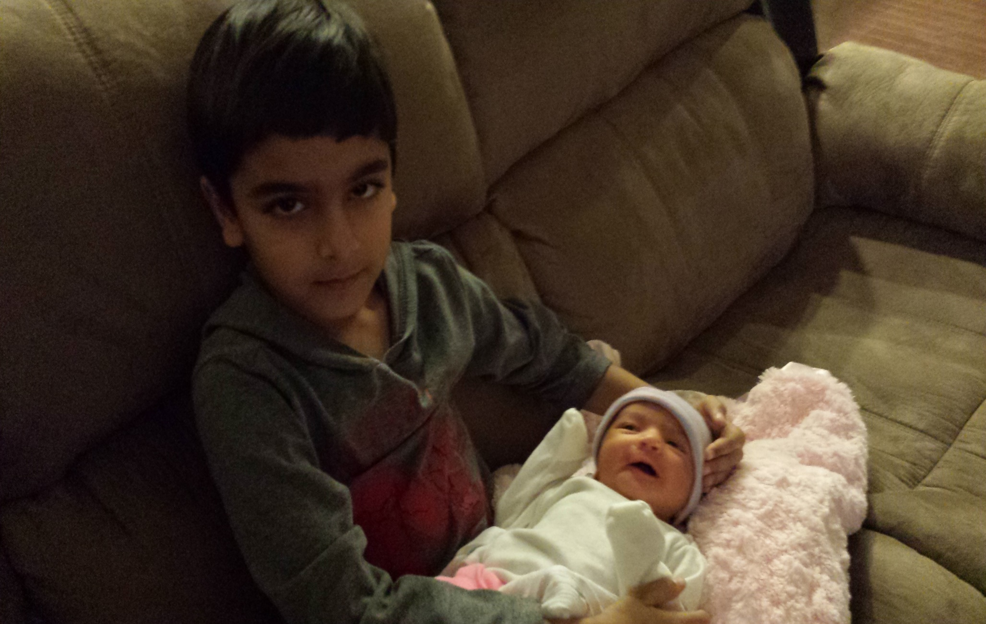
Veer’s journal

Slide 2
How much do you know about me?
I have 2 year old sister.
I know a lot about dinosaurs.
I know a lot about animals.
I am having trouble beating my dad in a video game called ultra street fighter 4.
I love to play guitar.
My goal is to be a paleontologist.

Slide 3
FAVORITES
COLORS: red , blue and black
FOOD: burgers , pizza and Chinese rice
SHOW: Lab Rats and Wild Kratts
CARD GAME: speed and war
ANIMAL: peregrine falcon and Eastern box turtle

Slide 4
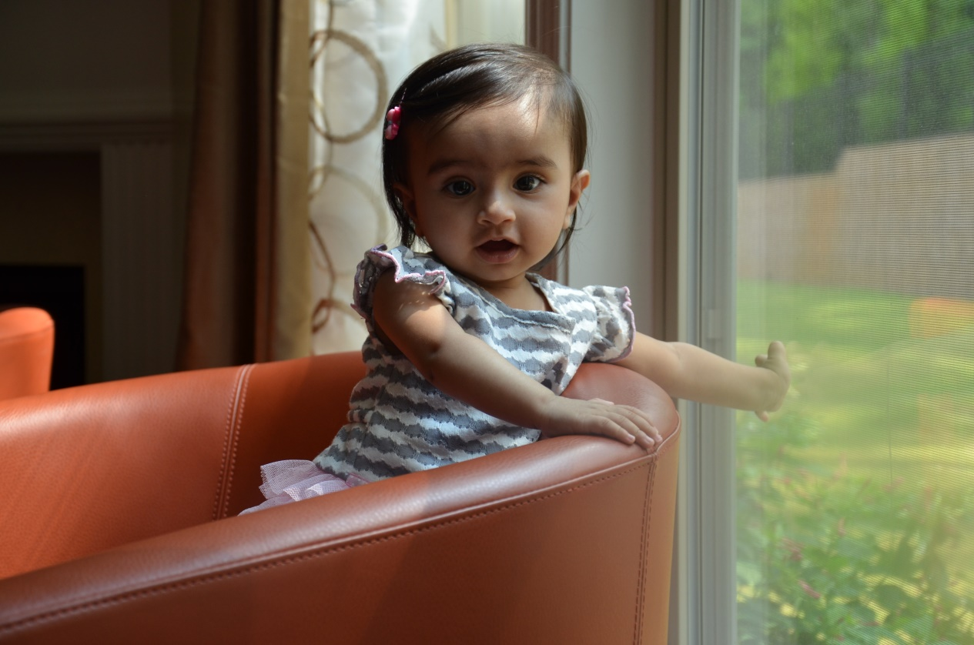
My 2 year old sister roshni
My sister is now 2 years old.
She is still mischievous… …and funny.
when
Roshni was 1 year old.

Slide 5
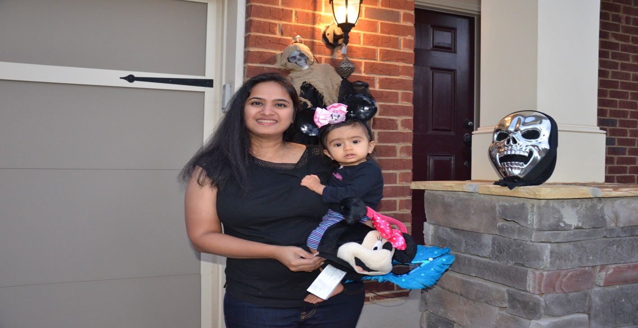
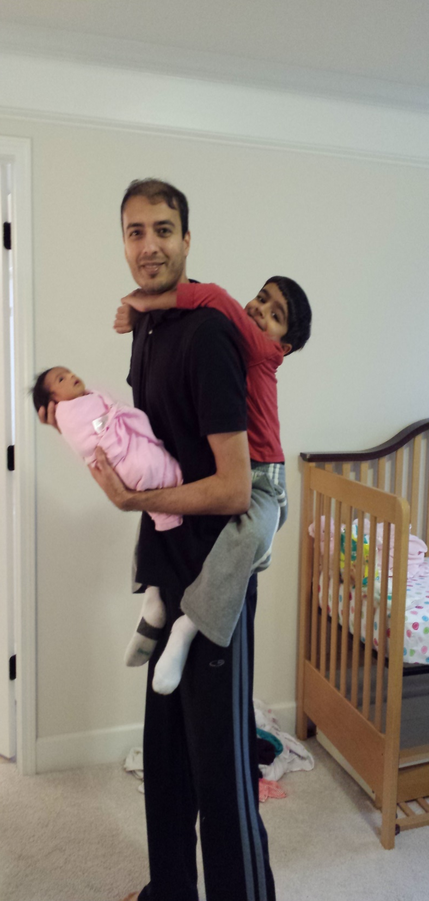
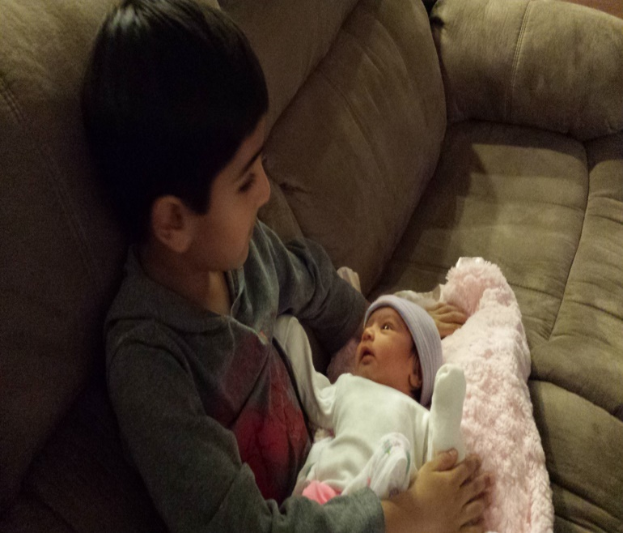
pictures

